Slide 1


OTT Platforms:
A Comparative Analysis
By Chandni Upadhyay

Slide 2

CONTENT
1. THE CASE STUDY
3. PLATOFORMWISE TOTAL CONTENT
5. PLATFORMWISE AVERAGE RATINGS
6. TOP 100 RELEASES ACROSS THE PLATFORMS
7. YEARLY TREND OF CONTENT RELEASED ON VARIOUS OTT PLATFORMS
8. TARGET AUDIENCE OF VARIOUS OTT PLATFORMS
9. GENNRE DISTRIBUTION ACROSS THE OTT PLATFORMS
4. IMDb VS ROTTEN TOMATOS
10. PLATFORMWISE GENRE DISTRIBUTION
11. TOP 5 PREFFERED GENRE
12. LANGUAGE DISTRIBUTION ACROSS ALL THE PLATFORMS
13. REGIONAL INFLUENCE ON RATING
14. OBSERVATIONS
2. OBJECTIVES

Slide 3
THE CASE STUDY
A brief introduction to the dataset
The dataset comprises of two tables
Movie dataset
TV show dataset
Both the datasets provide a comprehensive overview of various corresponding titles, including their ratings, availability on streaming platforms, releasing year, target audience, and more.
The dataset contains information about content streaming on NETFLIX, PRIME VIDEOS, DISNEY+ and HULU .
The dataset contains information about content released up to 2021

Slide 4
OBJECTIVES
TO IDENTIFY THE QUANTITY OF THE CONTENT OFFERED BY EACH PLATFORM
TO ANALYZE QUALITY OF EACH STREAMING SERVICES
TO ANALYZE YEARLY TREND
TO ANALYZE TARGET AUDENCE OF EACH PLATFORM
TO STUDY RATINGS BY AGE GROUP
TO EXPLORE GENRE PREFFERENCES
TO EXAMINE LANGUAGE AND COUNTRY DIVERSITY
TO IDENTIFY TOP 100 CONTENT

Slide 5
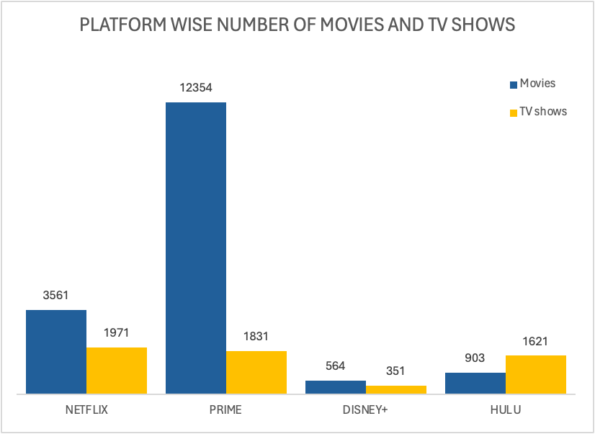
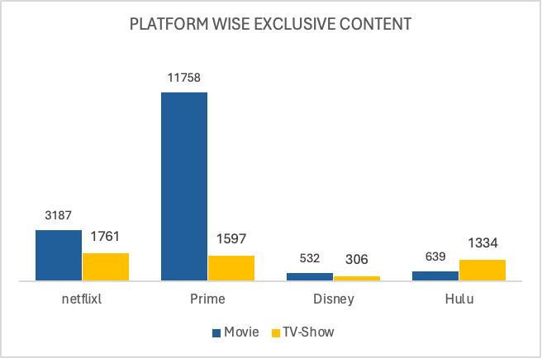
PLATFORMWISE TOTAL CONTENT
Prime dominates the movie market by making 74% of the movies available in its library.
95% of the prime content are exclusive.
NETFLIX slightly beats the PRIME videos by offering 37% of the of the total TV-shows where 89% of them are exclusive.

Slide 6
IMDb VS ROTTEN TOMATOES
How these rating agencies rate different shows or movies?
IMDb Ratings
Rotten Tomatoes Ratings
Ratings on IMDb are primarily based on user’s reviews.
IMDb Ratings are trustworthy in telling the average rating given to movies by visitors.
If the rating is 8.0 or above a movie is considered as a good movie and its worth watching.
Rotten Tomatoes ratings are primarily based on professional reviews from approved critics.
Rotten Tomatoes are trustworthy in telling the percentage of film critics who gave the movie a positive review.
If the positive reviews make up 60% or more, the film is considered "fresh". If the positive reviews are less than 60%, the film is considered "rotten”.

Slide 7
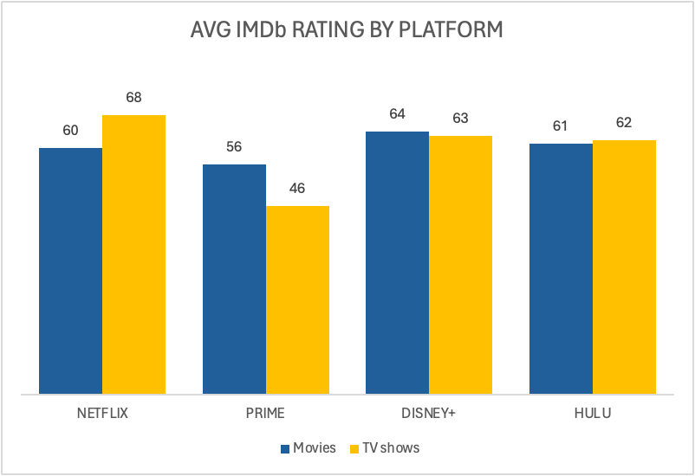
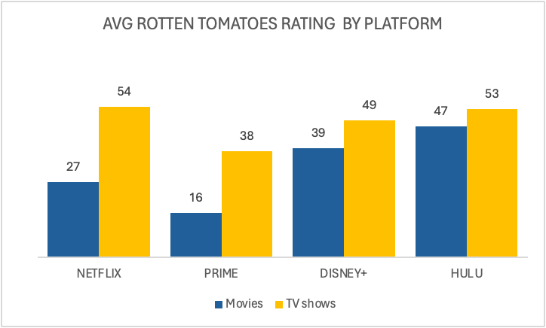
PLATFORMWISE AVERAGE RATING
According to IMDb DISNEY+ has highest average ratings for movies
NETFLIX leads in average rating for TV shows
Rotten Tomatoes users tend to rate Disney+ and Amazon Prime TV shows more critically.
Amazon Prime's extensive movie catalogue may contribute to its lower average movie rating, reflecting diverse content offerings.

Slide 8
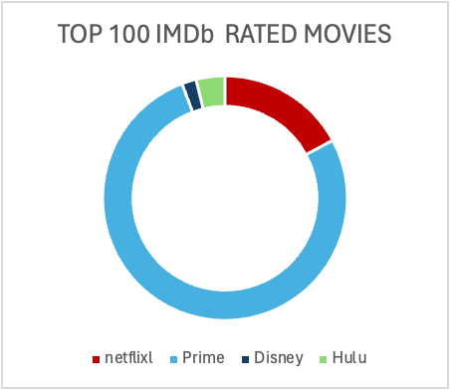
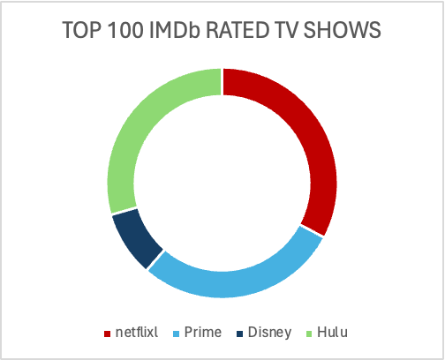
TOP 100 RELEASES
Prime videos movie library is dominating the other competitors
NETFLIX, PRIME and HULU shows a fare competition on top 100 TV-shows
In both the scenarios DISNEY+ has comparatively lesser content

Slide 9
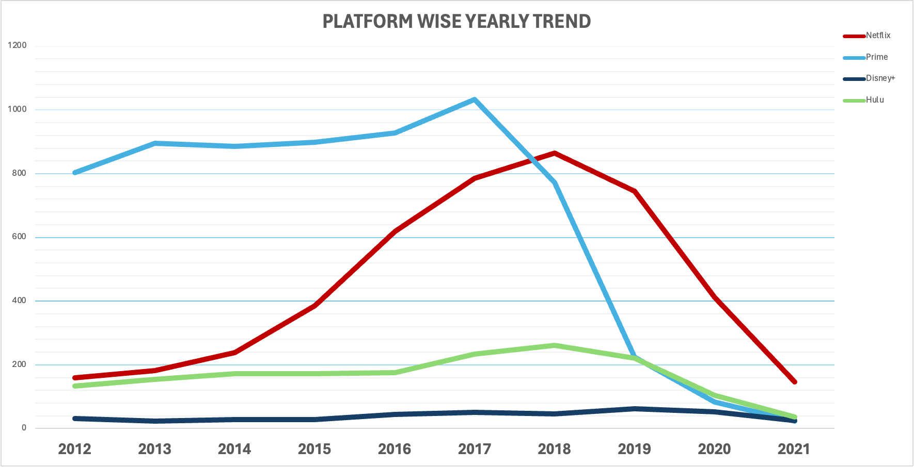
YEARLY TREND BY PLATFORM
Since 2018, Netflix has surpassed Amazon Prime in the number of new shows and movies released.
Prime Video experienced a significant decrease in newly released content in 2019, contributing to Netflix's dominance in new content offerings.
IN 2021 every platform has experienced lesser number of releases

Slide 10
PLATFORMWISE TARGET AUDIENCE
Age | Netflix | Prime | Disney+ | Hulu
18+ | 1234 | 2776 | 5 | 551
16+ | 473 | 434 | 22 | 518
13+ | 386 | 821 | 40 | 125
7+ | 622 | 1129 | 288 | 434
all | 306 | 579 | 406 | 179
Netflix, Amazon Prime, and Hulu mainly target adults (18+)
DISNEY+ is majorly dominated by the kids and universal content
Hulu has most content for Adults and young adults(16+), other platforms are not focusing much on this age group.
Netflix, Amazon Prime, and Hulu also have enough content for kids
Average ratings for content targeting Young Adult audience is highest
The numbers in cells indicate the total content

Slide 11
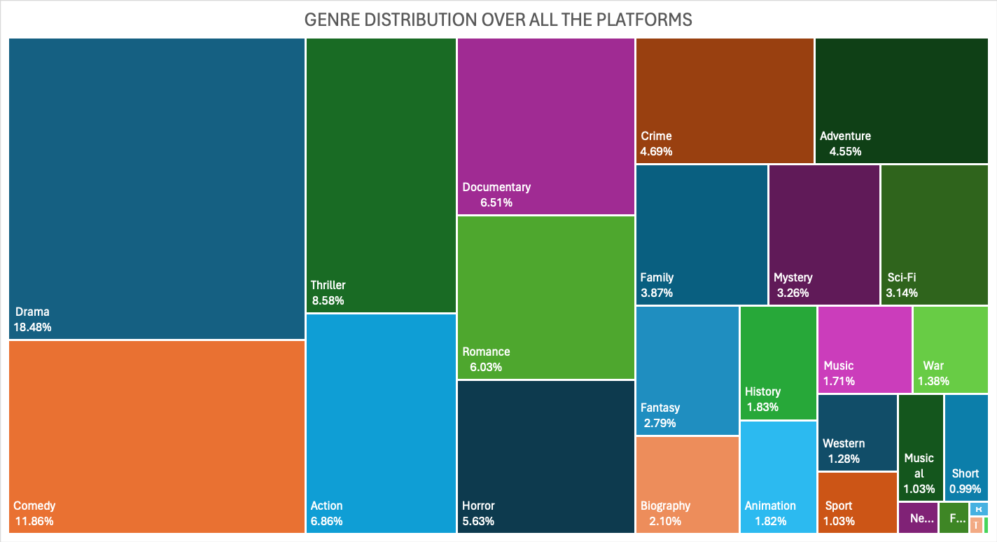
GENRE DISTRIBUTION ACROSS ALL THE PLATFORMS
Drama is the highest available content followed by Comedy, Thriller and Action

Slide 12
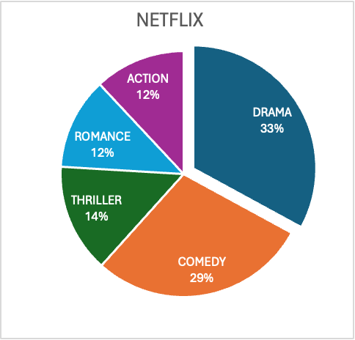
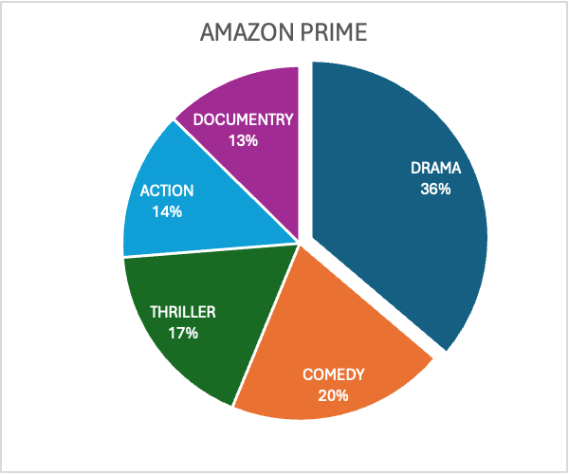
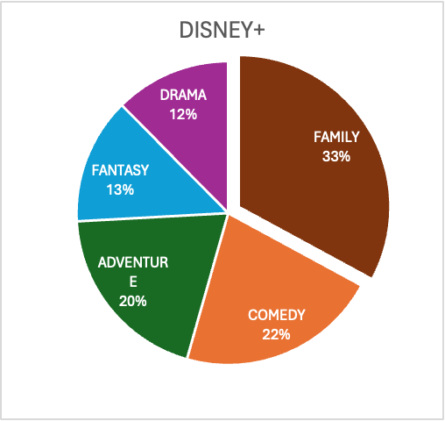
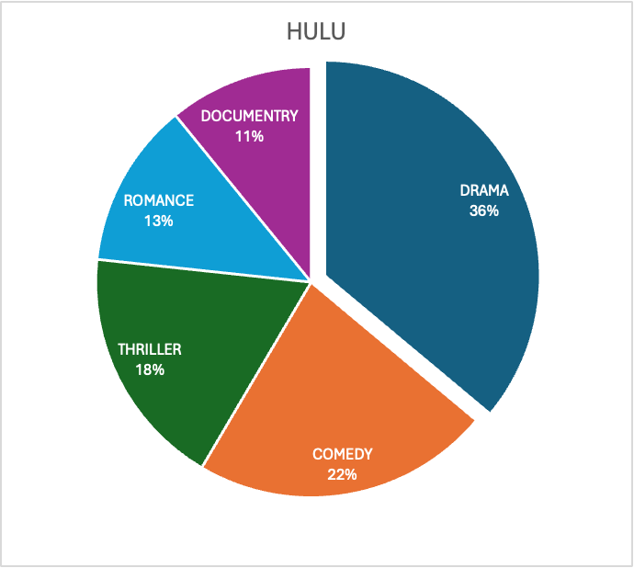
PLATFORMWISE GENRE DISTRIBUTION
Drama emerges as the most common genre across all four streaming services
Drama is the most prevalent genre on three platforms, except for Disney+, where Family takes the lead
As target audience for Disney+ are kids aligning with family centric genre
Comedy is the second most common genre across all the platform
Thriller is the third most common genre across all three platform except Disney+, where adventure takes the third spot

Slide 13
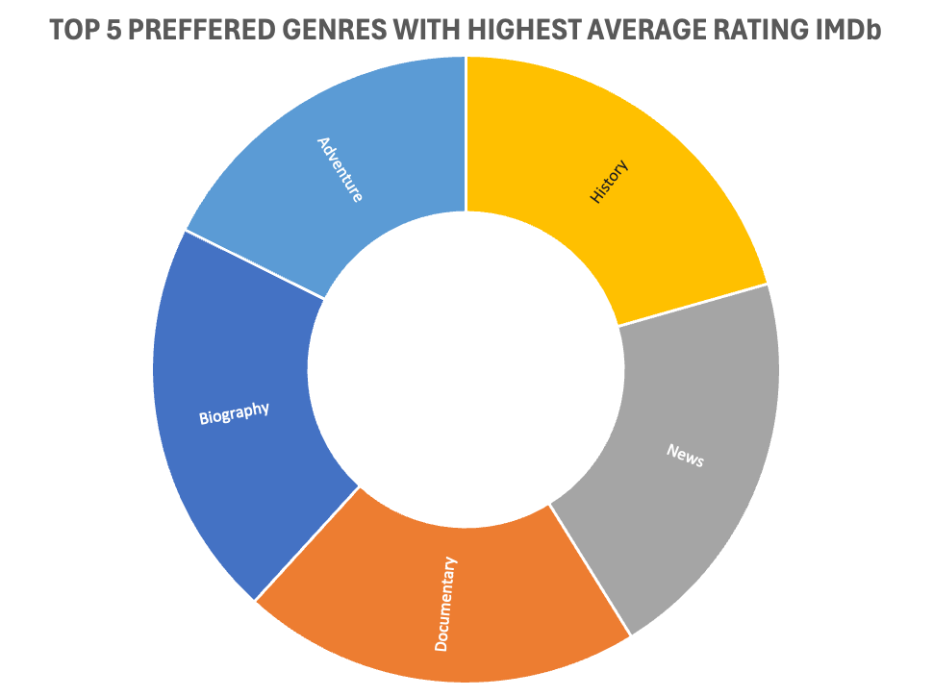
TOP 5 PREFFERED GENRES
Although drama, comedy and thriller are the most most common genre across the platform, viewers are more inclined towards factual movies

Slide 14
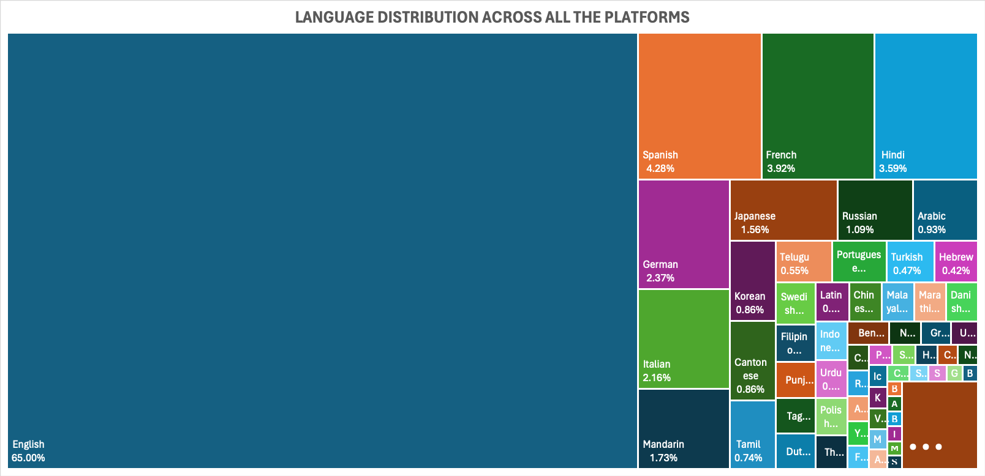
LANGUAGE DISTRIBUTION ACROSS ALL THE PLATFORMS
English is the most common language followed by Spanish, French and Hindi

Slide 15
REGIONAL INFLUENCE ON RATING
Despite having the highest number of content in English language, the contents made in regional language are getting higher ratings
TOP 5 MOST POPULAR LANGUAGES | TOP 5 HIGH RATED LANGUAGES
ENGLISH | XHOBA
SPANISH | NEPALI
FRENCH | BRAZILIAN SIGN LANGUAGE
HINDI | NYANJA
GERMAN | JAPANESE SIGN LANGUAGE
TOP 5 MOST POPULAR COUNTRIES | TOP 5 HIGH RATED COUNTRIES
UNITED STATES | TUN
UNITED KINGDOME | BOSNIA and HERZEGOVINA
INDIA | NEPALI
CANADA | SOMALIA
FRANCE | HAITI
English is the most common language across all the platforms
All the platforms are targeting English speaking country
Regional content are getting higher ratings than mainstream content.

Slide 16
OBSERVATIONS
Amazon prime dominates the movie market whereas Netflix tops the tv show game.
Target audience for most of the platforms are Adults whereas Disney+ makes more family friendly content.
Drama is the most common genre with almost 19% of the total content whereas, users are more inclined towards factual genre.
English being the most popular language has lower IMDb score as compared to the regional language
There is very lesser content for Young Adult(16+) audience

Slide 17
THANK YOU!

